Slide 1

Hr. analytics
GROUP 3
Rachana
Vaibhavi
Sadiq
Haritha

Slide 2
Hr. analytics
Rachana
GROUP 3
Haritha
Vaibhavi
Sadiq

Slide 3
INTRODUCTION
Human Resource(HR) Analysis plays a crucial role in helping organizations make informed decisions about their workforce. By systematically examining employee-related data, HR analysis provides insights into areas such as hiring trends, attrition rates, employee performance, engagement levels, and workforce diversity. This analysis supports strategic planning, helps identify areas for improvement, and ensures that HR initiatives align with business objectives. Through data- driven insights, organizations can enhance productivity, retain top talent, and create a more effective and inclusive work environment.

Slide 4
OBJECTIVES
Improve Recruitment and Talent Acquisition
Enhance Employee Performance
Reduce Employee Turnover
Improve work force planning
Optimize compensation and benefits
Strengthen employee engagement
Support diversity, equity and inclusion
Align HR strategy with business goals

Slide 5
Our Analytical Framework: Data and Methods
We conducted a comprehensive analysis of HR data to uncover patterns in employee attrition, gender diversity, income distribution, tenure, and promotion history. The dataset included demographic information, job roles, working years, compensation details, and work-life balance metrics.
Our objective was to identify key drivers of attrition and uncover actionable insights that support workforce planning and retention strategies. We examined departmental trends, gender-based distributions, tenure correlations, and job role performance to aid data-driven HR decision-making.
We Used
SQL for extracting and querying structured HR data from relational databases
Power query for cleansing, shaping, and transforming employee datasets
Excel to identify trends and calculate key HR indicators such as attrition rate, average tenure, and income
Tableau to explore supplementary insights for specific employee segments

Slide 6
KEY PERFORMANCE INDICATORS
Average Age
Average Attrition
Average Hourly Rate
Average Tenure
Average Income

Slide 7
INSIGHTS
📊 1. Attrition Rate by Department Top 3 High Attrition Depts :
Research & Development: 51.21%
Software: 50.54%
Support: 50.19%
🔍 Insight : All departments have attrition around 49–51%, showing broad organizational attrition – not isolated.
✅ Suggestions : Investigate overall employee experience & management style.
Launch retention initiatives (training, rewards, mentoring).
🟣 2. Count of Employees by Gender (Pie Chart)
Male: ~25,060 (50.1%)
Female: ~24,940 (49.8%)
🔍 Insight : Gender balance is nearly perfect. Great diversity representation.
✅ Suggestions : Maintain this balance in leadership hiring and promotions.
Promote inclusive policies, especially for retention and flexibility.
🟤 3. Attrition Rate vs Monthly Income by Department (Scatter Plot)
Departments with higher income don’t always have lower attrition:
Sales & HR earn more but still show 50%+ attrition.
Hardware has lowest attrition and also lowest income.
🔍 Insight:💰 Income alone does not reduce attrition — employee satisfaction may rely on other factors like culture, WLB, recognition.
✅ Suggestions: Focus on non-monetary factors: culture, promotions, recognition.Do pulse surveys to find department-wise reasons for leaving

Slide 8
🕒 4. Attrition Rate by Years Since Last Promotion (Area Chart)
Huge spike at 36 years: 77.78% attrition
Another spike at 32 years: 60.53%
Drop to 0% attrition at 40 years (likely very few employees)
🔍 Insight:🧨 Delayed or no promotions = higher attrition.
✅ Suggestions: Design clear promotion cycles or criteria.
Introduce career path frameworks for employees.
🧱 5. Average of Total Working Years by Department (Bar Chart)
Most departments have around 20.3–20.65 years average tenure.
Suggests employees stay long but still leave → signals dissatisfaction.
🔍 Insight: Loyal employees are leaving, possibly due to lack of motivation or reward.
✅ Suggestions: Introduce long-service awards, sabbaticals, role rotations.
Refresh job roles or create leadership pipelines.
🧘 6. Average Work-Life Balance by Job Role (Bar Chart)
Fairly consistent (2.47–2.51 out of 5).
Sales Executive has the lowest WLB (2.47).
🔍 Insight: WLB is average across roles, but Sales teams may be overburdened.
✅ Suggestions: Consider flexible hours, reduced targets, or assistant roles in Sales.
Track WLB feedback regularly with e NPS / WLB scores.

Slide 9


Slide 10
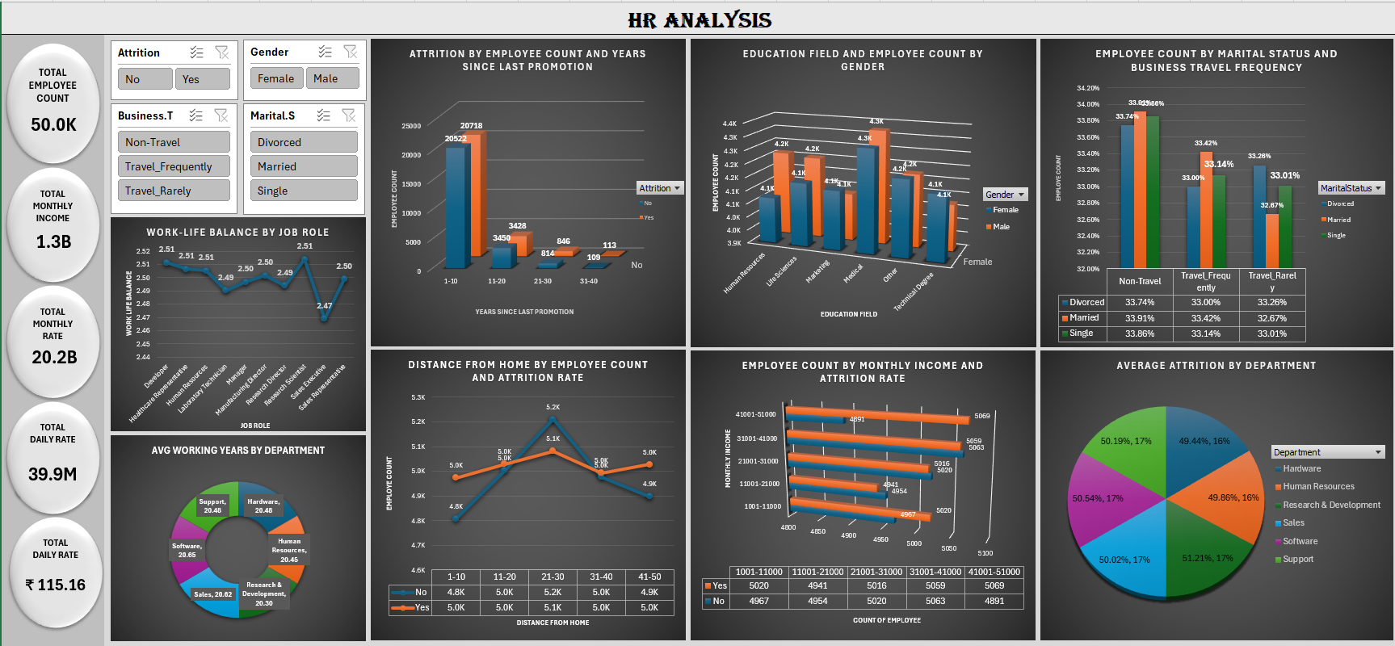

Slide 11


Slide 12
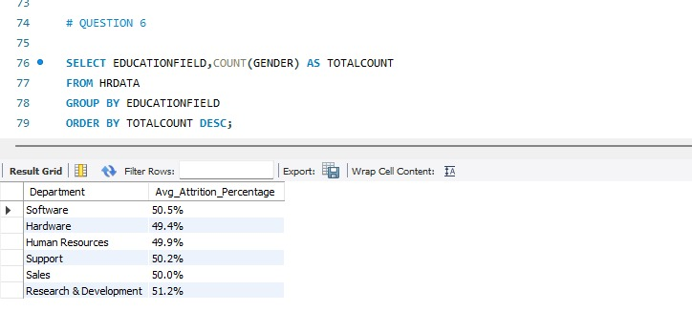
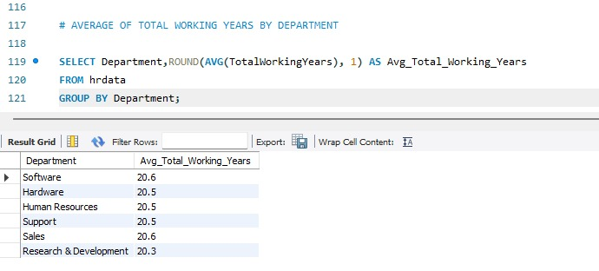
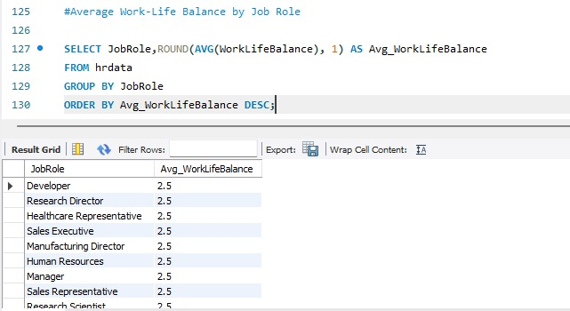
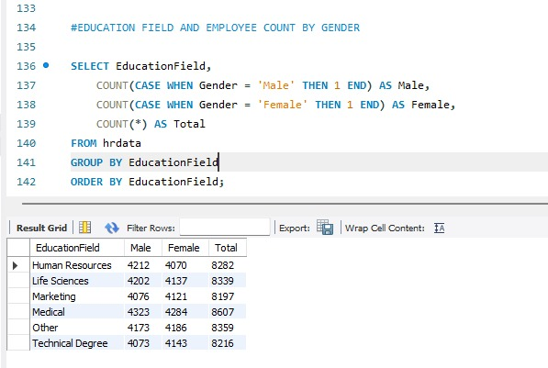

Slide 13
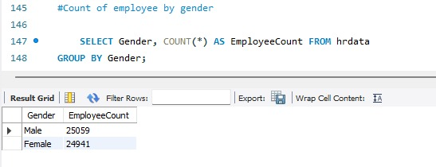
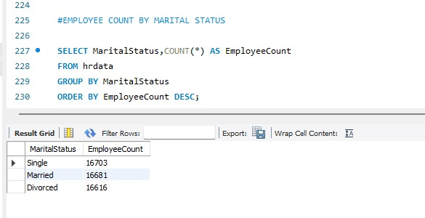
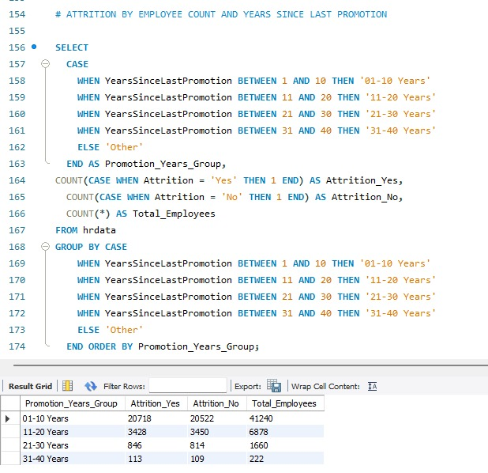
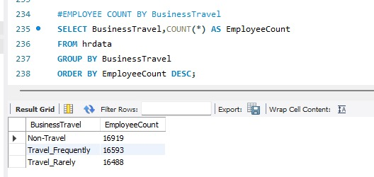

Slide 14

TABLEAU

Slide 15
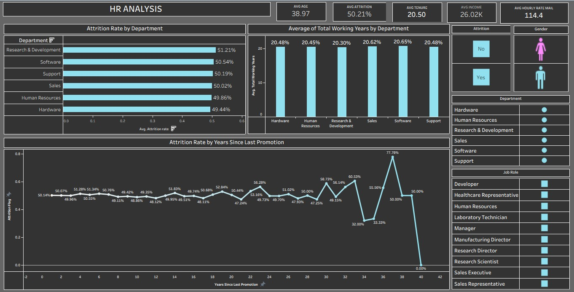

Slide 16
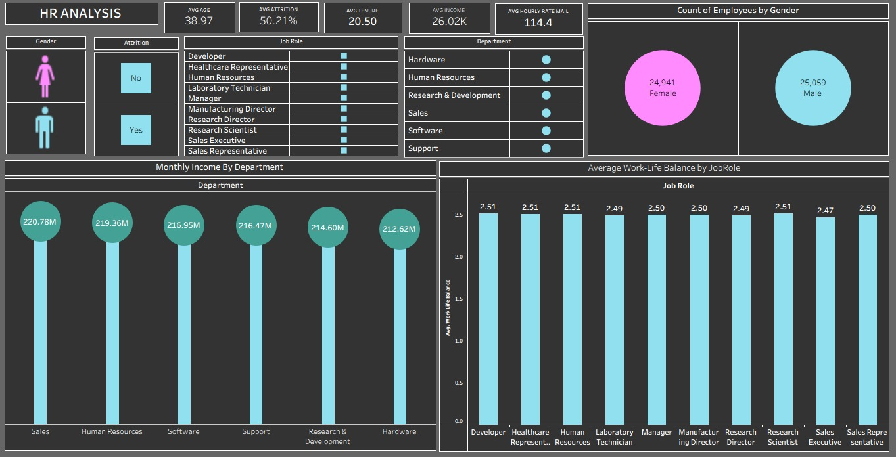

Slide 17



Slide 18
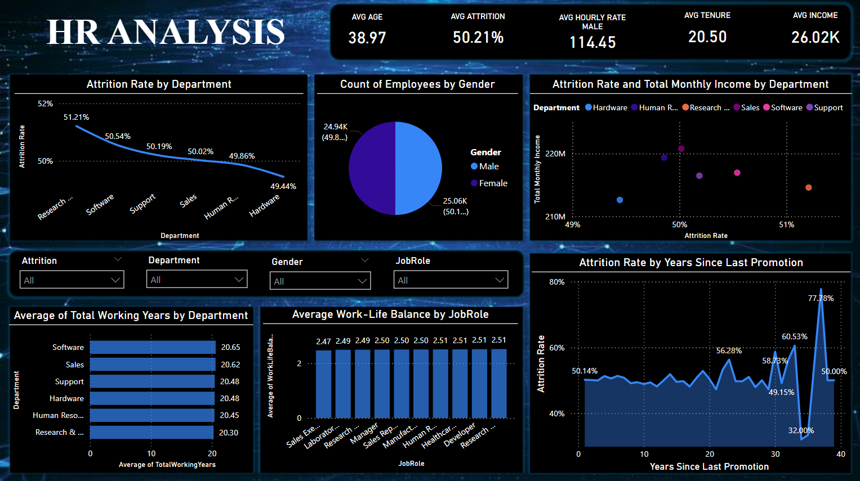

Slide 19
SUMMARY
This comprehensive HR dashboard offers a strategic view of the organization’s workforce dynamics, focusing on attrition trends, employee demographics, and departmental performance. It reveals an overall attrition rate of 50.21%, with the highest attrition observed in the Research and software departments, and the lowest in the Hardware.
The dashboard highlights key metrics such as an average employee age of 38.97 years, average tenure of 20.5 years, and monthly income averaging 26.02k. Gender distribution remains nearly balanced, with a 50:50 male-to-female ratio.
It also provides insights into income and attrition trends across departments, work-life balance by job roles, and attrition patterns based on years since last promotion indicating potential retention risks for employees with long stagnation in promotions.
These insights empower HR and leadership teams to make informed decisions on talent retention, workforce planning, and organizational development, while helping optimize employee satisfaction and long-term performance.

Slide 20
THANK YOU

